Slide 1
Updates
Last Edited: on 04/16/2020

Slide 2
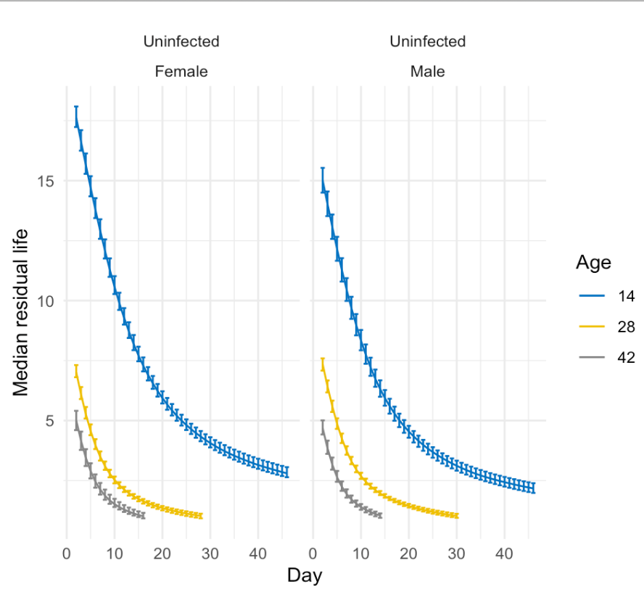
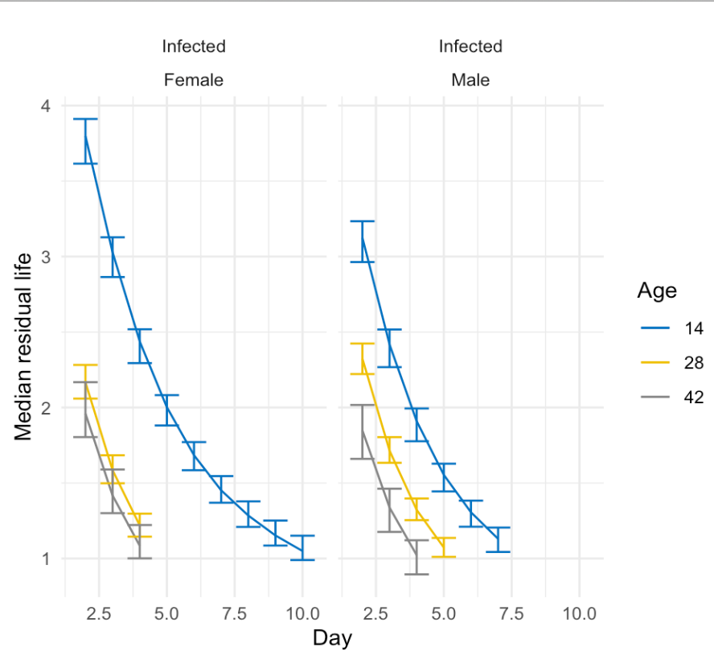

Slide 3
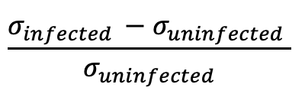
ACO -- Immunity measurement
Below are the changes of scales between infected and uninfected.
$$\frac{σ_{infected }−σ_{uninfected} }{σ_{uninfected}}$$
Age | Sex | Estimates | 95% Intervals
Age 14 | Female | 0.01631 | (0.01514, 0.01730)
 | Male | 0.01885 | (0.01754, 0.02019)
Age 28 | Female | 0.05403 | (0.04800, 0.05881)
 | Male | 0.05208 | (0.04746, 0.05798)
Age 42 | Female | 0.08421 | (0.07605, 0.09671)
 | Male | 0.08925 | (0.08141, 0.10134)

Slide 4
CO -- Immunity measurement
Below are the changes of scales between infected and uninfected.
$$\frac{σ_{infected }−σ_{uninfected} }{σ_{uninfected}}$$
Age | Sex | Estimates | 95% Intervals
Age 14 | Female | 0.01070 | (0.00977, 0.01187)
 | Male | 0.01202 | (0.01122, 0.01316)
Age 28 | Female | 0.01544 | (0.01415, 0.01678)
 | Male | 0.01722 | (0.01589. 0.01850)
Age 42 | Female | 0.03127 | (0.02786, 0.03391)
 | Male | 0.05107 | (0.04625 ,0.06039)
Age 56 | Female | 0.09071 | (0.08209, 0.10411)
 | Male | 0.09939 | (0.08022, 0.11243)
Age 70 | Female | 0.17654 | (0.15904, 0.20335)
 | Male | 0.19171 | (0.16092, 0.22467)

Slide 5
Model on
Control vs Uninfected
Updated: 04/15/2020

Slide 6
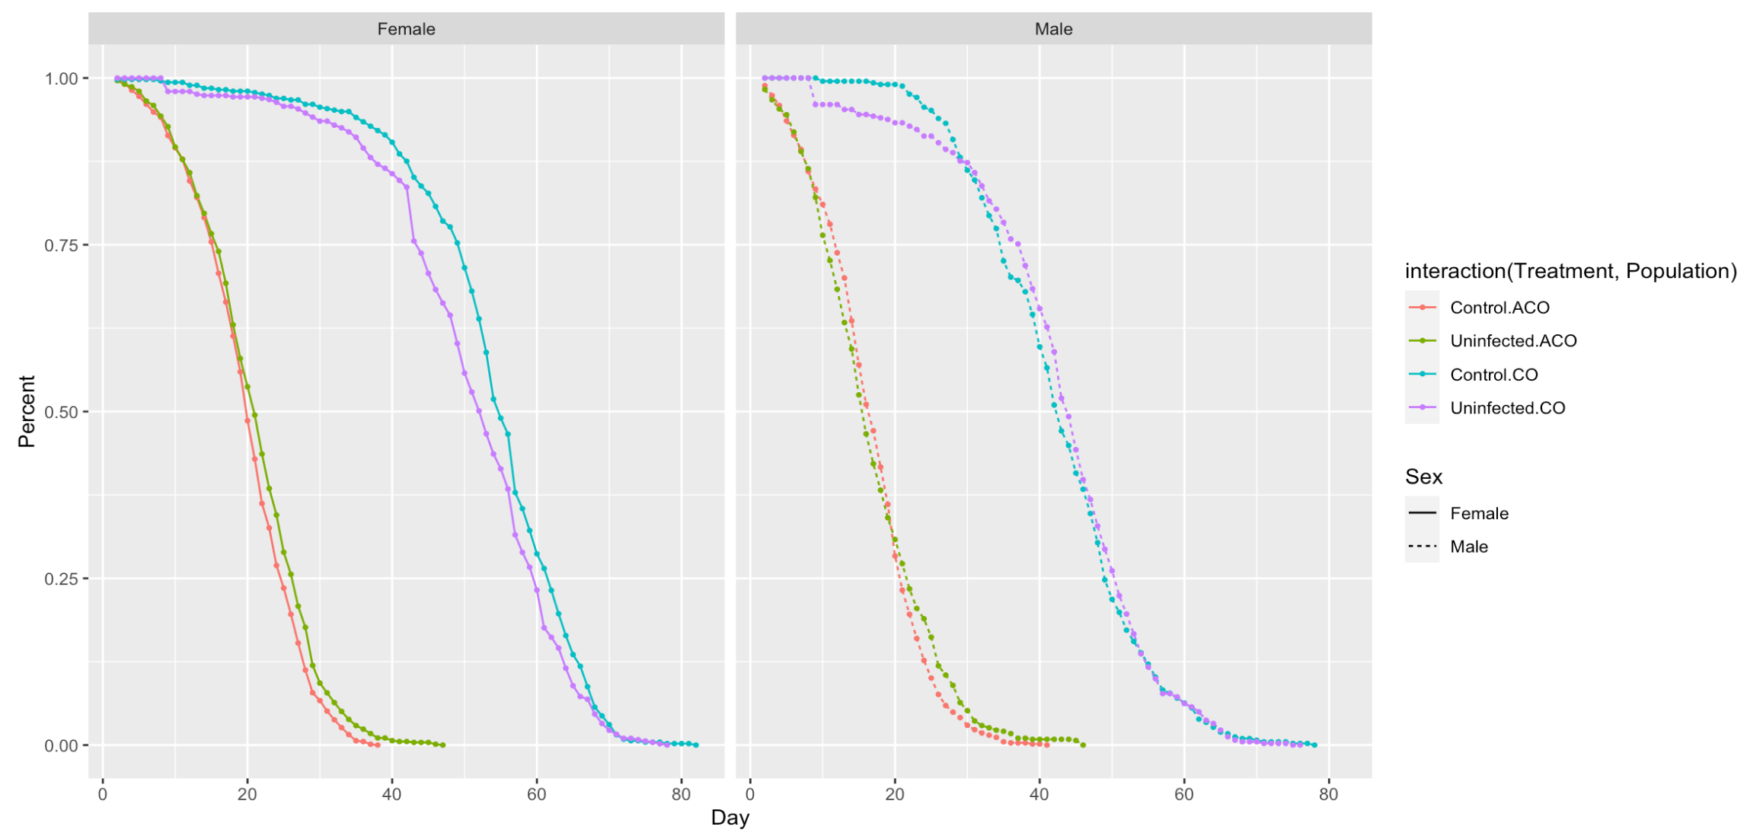

The model fails to capture this sharp decrease in a “short” period. The model is smoothing out the entire curve and thus doesn’t identify any significant difference between control and uninfected for CO male flies.
Raw data plot

Slide 7

However, our model captures the difference between control and uninfected for CO female flies and identifies it as significant. And the control group survives better than the uninfected
Raw data plot
Gap increases

Slide 8



Both ACO female flies and ACO male flies have smooth survival curves without any sharp change in a short time period so it’s easier to check our model using the raw data plot. Control and uninfected in both panel are close to each other at the early stage and then control groups experience a decrease after a time point. Thus we will see the model concludes that control has more hazard than uninfected
Raw data plot
time point
time point
Order reverses
Since the order reverses for ACO male flies, the hazard ratio would be a bit higher compared to the one of ACO female flies.

Slide 9
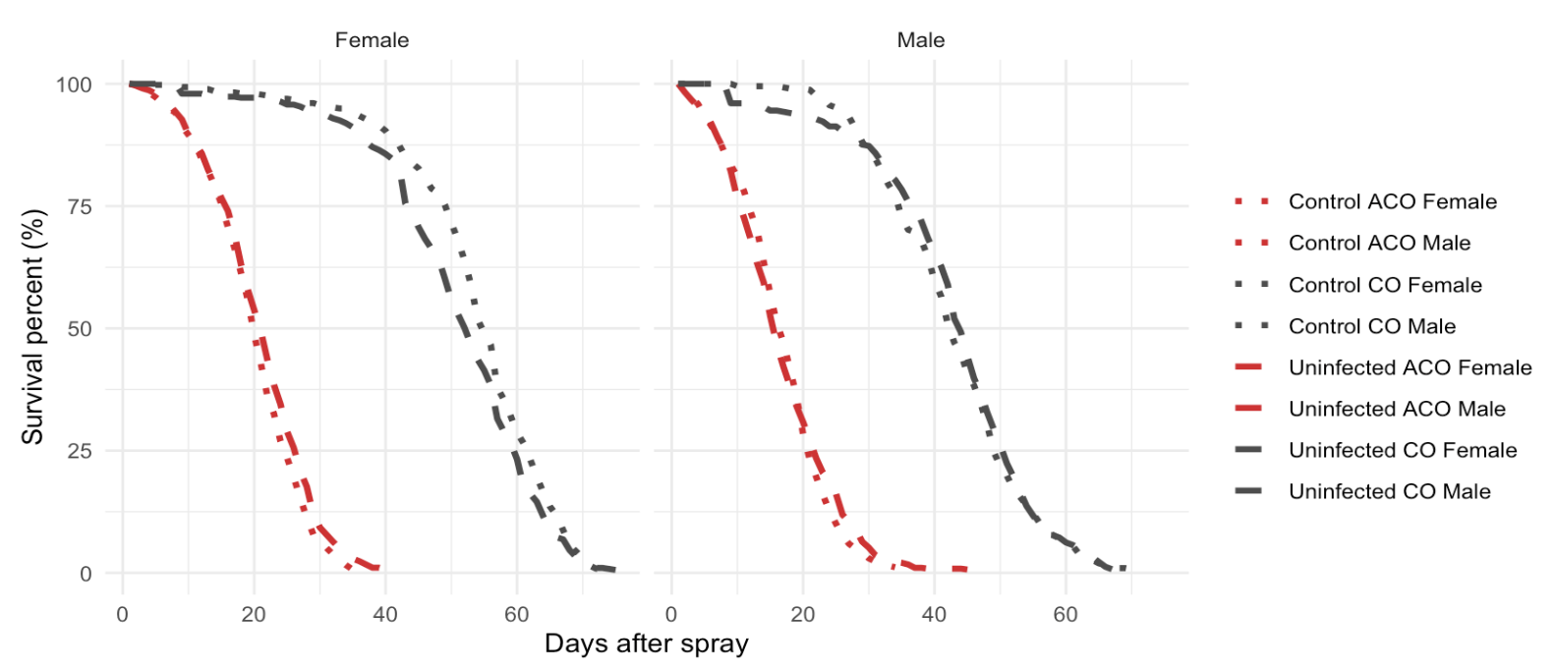
Raw data plot

Slide 10
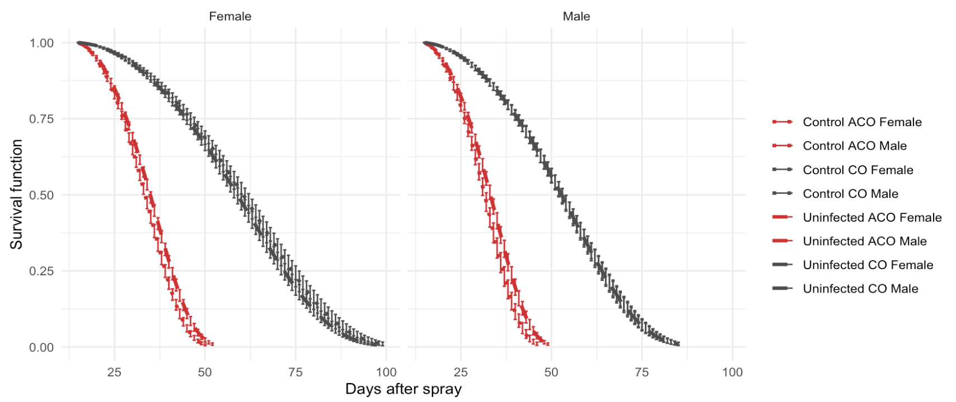
Model plot
Updated: 04/15/2020
Notes:
The updated model doesn’t change much from the last time. The conclusions (hazard ratio on slide #6) are:
1. The data supports that control and uninfected are different

Slide 11
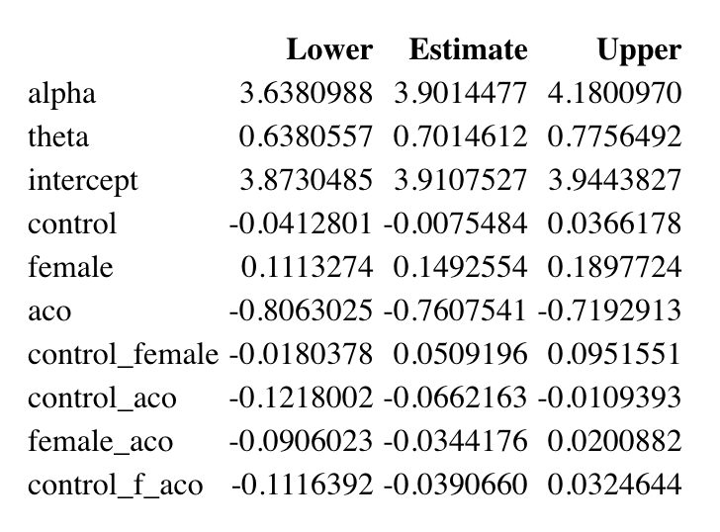
Coefficients
Updated: 04/15/2020

Slide 12
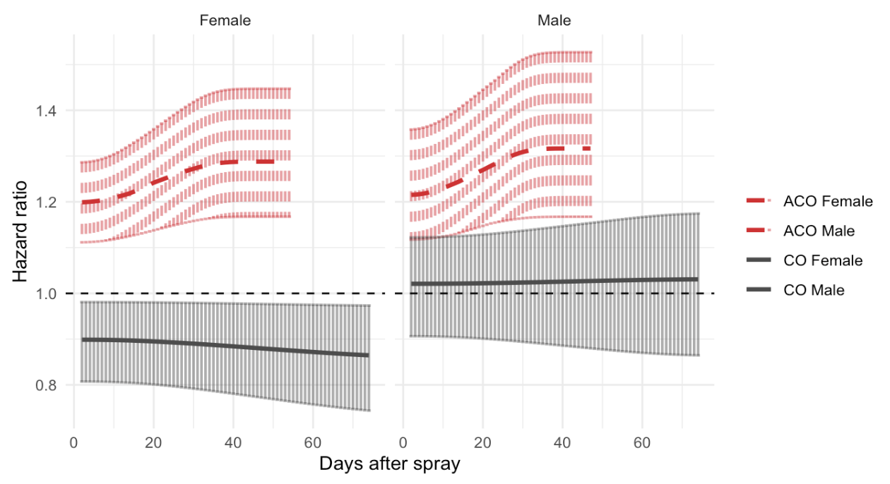
Hazard ratios
Updated: 04/15/2020

Slide 13
Model on
ACO

Slide 14
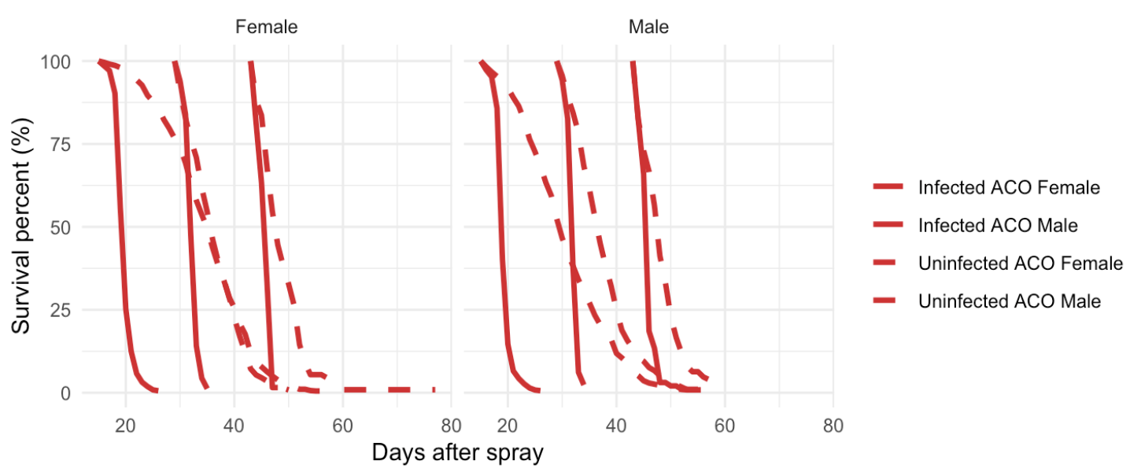
Raw data plot

Slide 15
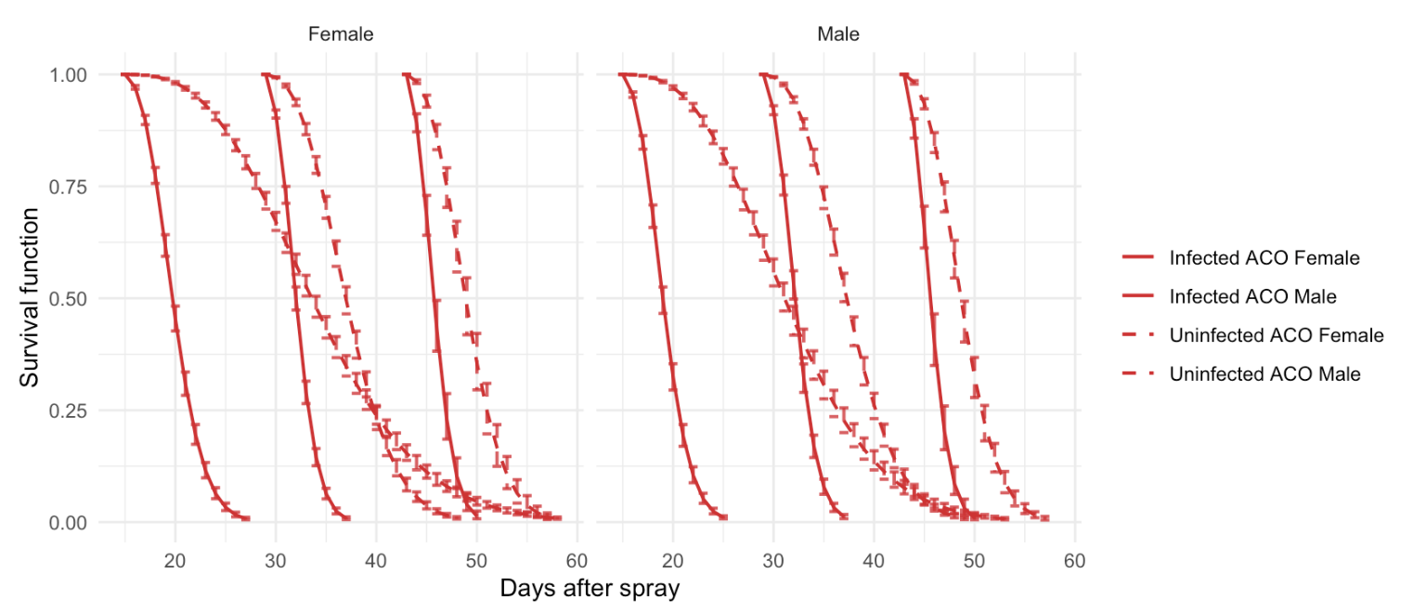
Model plot

Slide 16
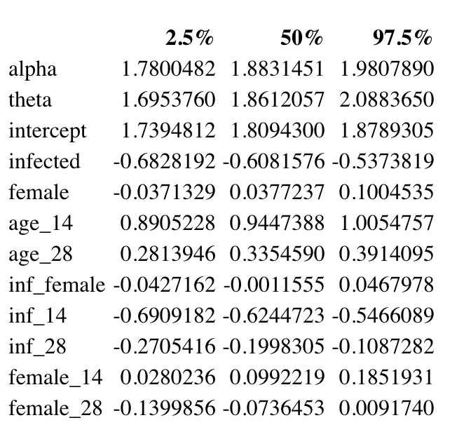
Coefficients

Slide 17
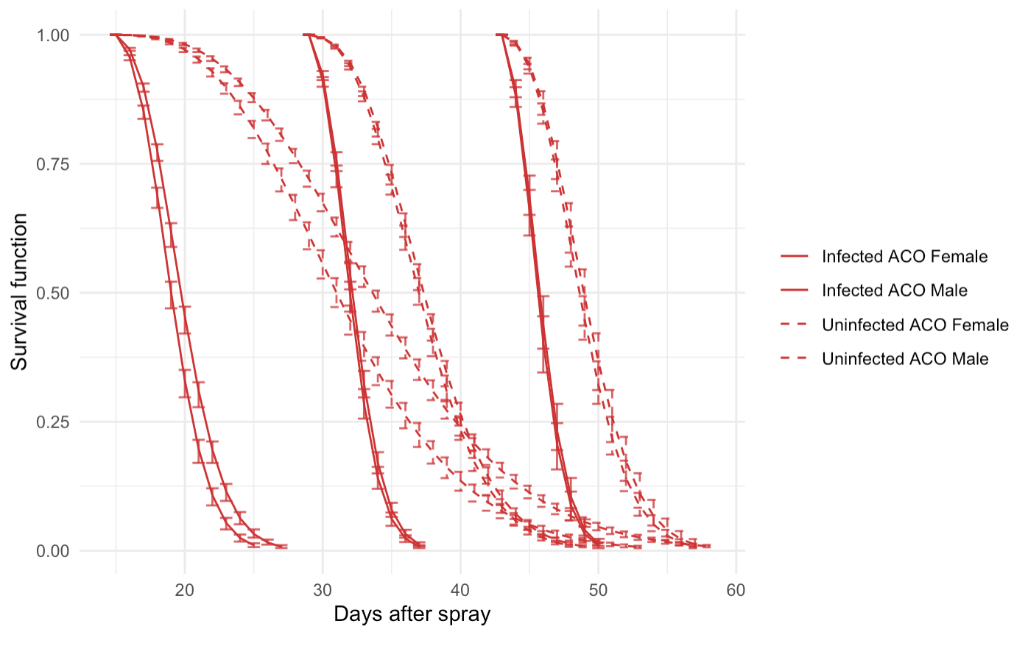
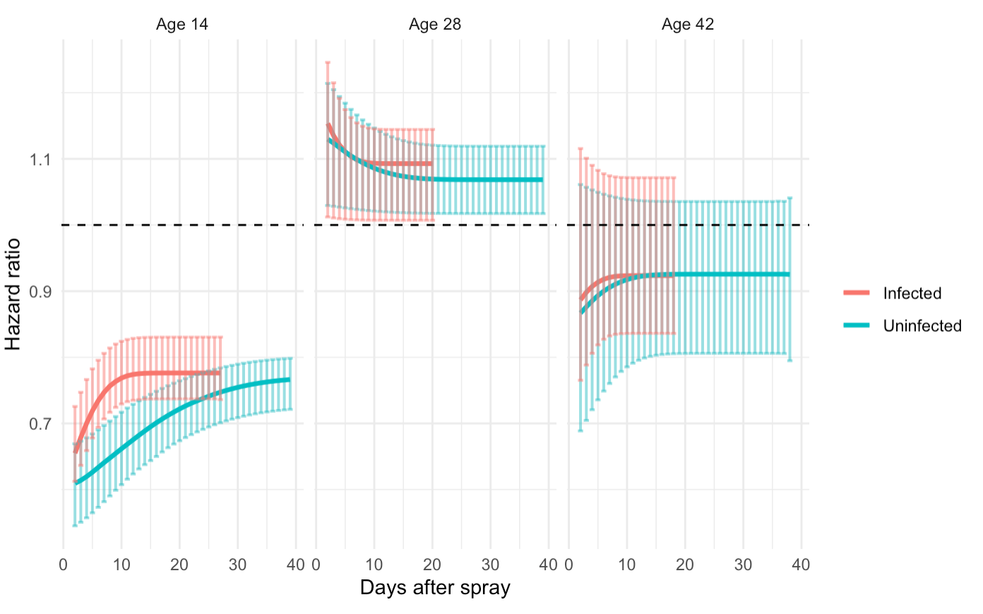
Hazard ratios
Top:
This plot overlays survival curves (model) of ACO male and ACO female flies. We can visually check the difference between males and females.
Below:
Hazard ratio between female and male when male as the baseline.
Updated: 04/15/2020

Slide 18
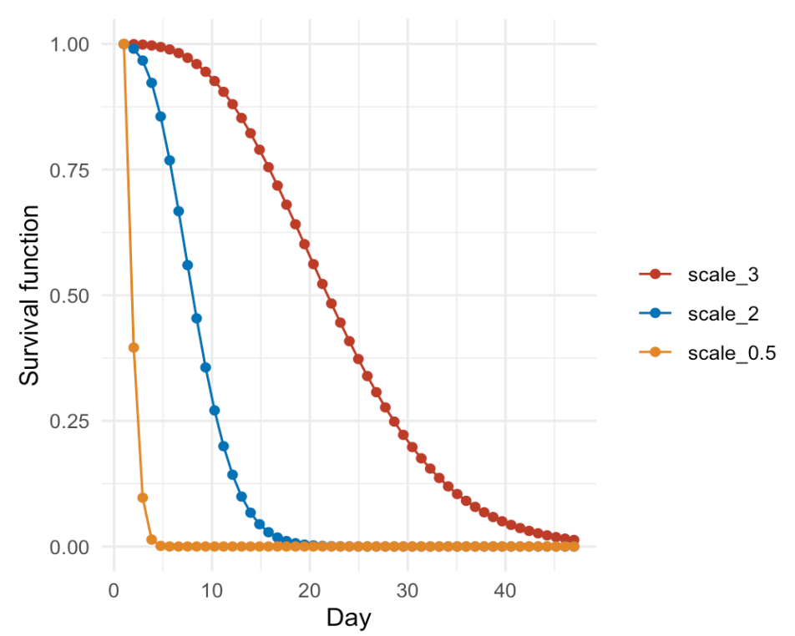
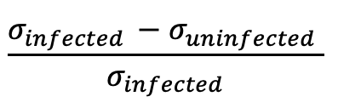
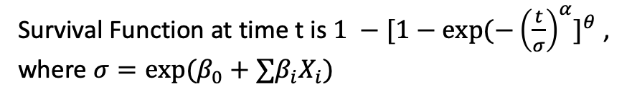
Immunity measurement
Below are the changes of scales between infected and uninfected.
Survival Function at time t is $1 −[1−exp⁡(−{\left(\frac{t}{σ}\right)}^{α}]^{θ}$,
where $σ=exp⁡(β_{0}+∑{β_{i}X}_{i})$
$$\frac{σ_{infected }−σ_{uninfected} }{σ_{infected}}$$
# age 14 measurement 0.06368858
# age 28 measurement 0.1171852
# age 42 measurement 1

Slide 19
Model on
CO

Slide 20
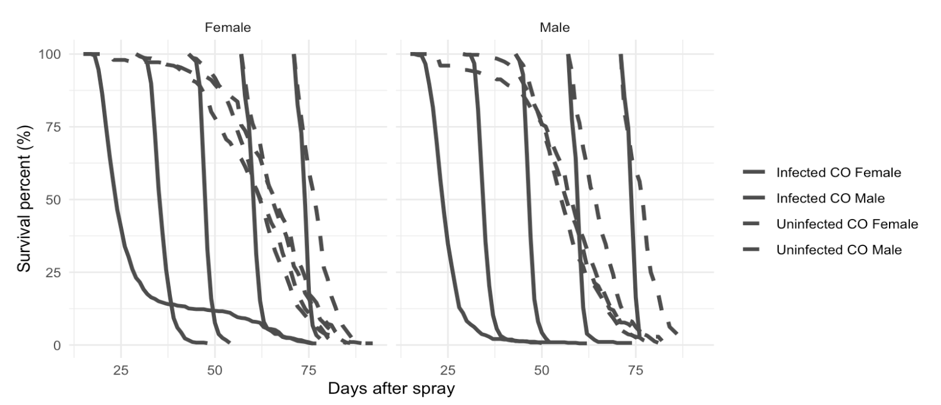
Raw data plot

Slide 21
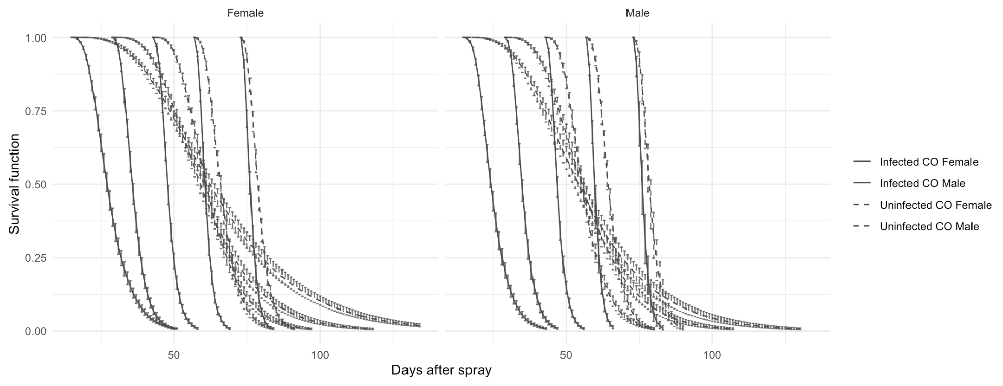
Model plot

Slide 22
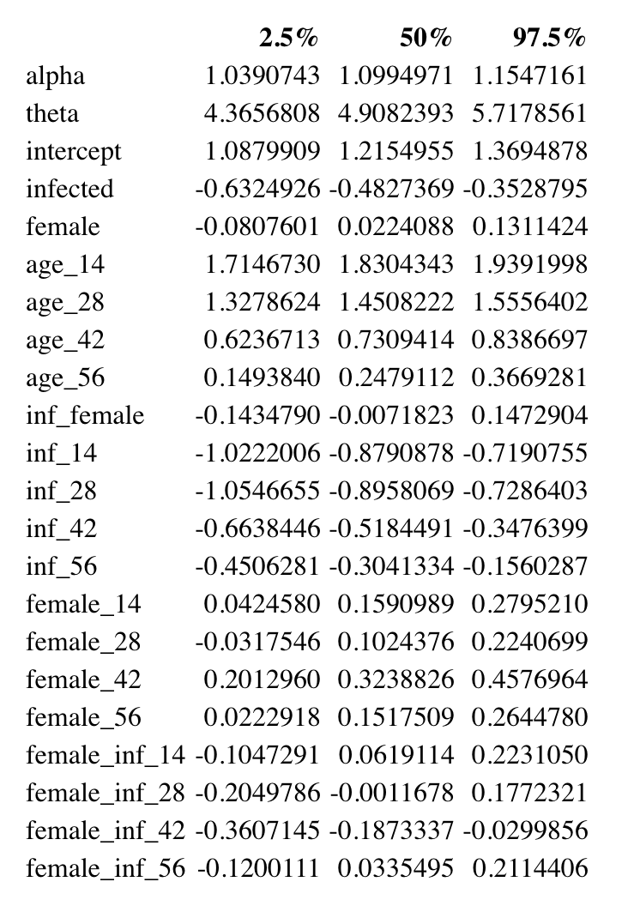
Coefficients

Slide 23
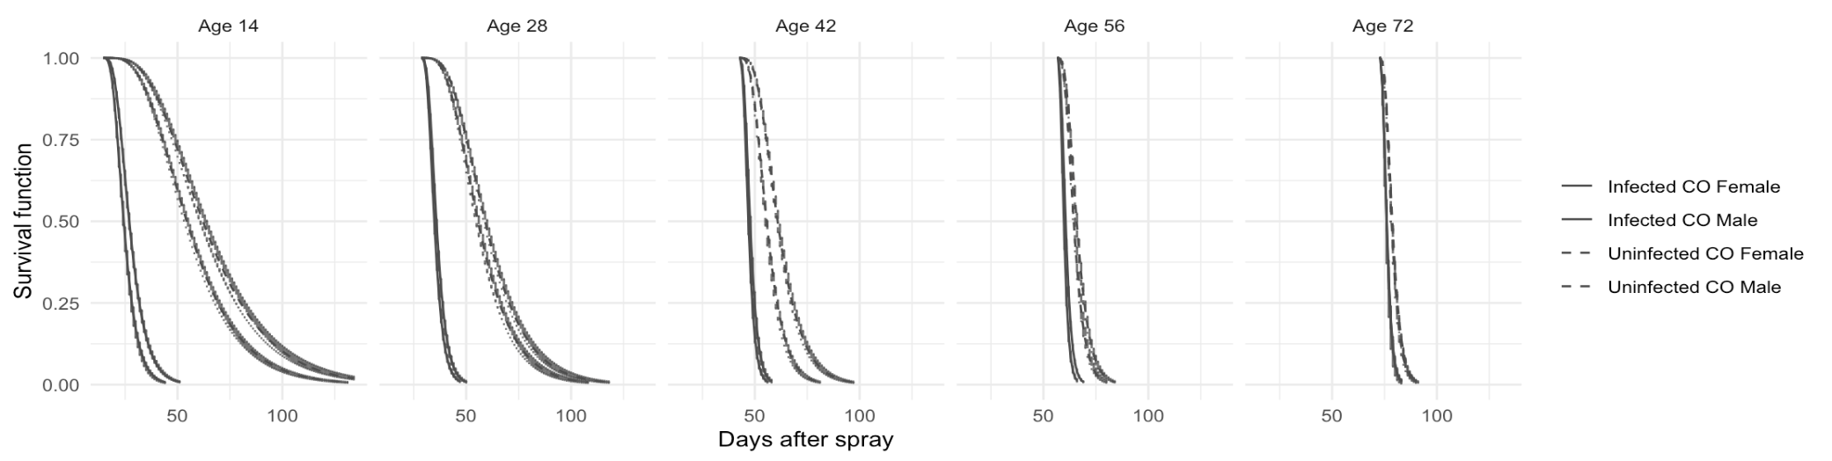
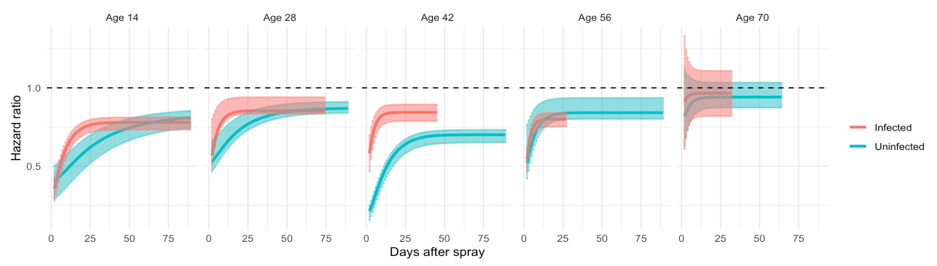
Hazard ratios
Top:
This plot overlays survival curves (model) of CO male and CO female flies. We can visually check the difference between males and females.
Below:
Hazard ratio between female and male when male as the baseline.
Updated: 04/15/2020

Slide 24
Immunity measurement
Below are the changes of scales between infected and uninfected.
Survival Function at time t is $1 −[1−exp⁡(−{\left(\frac{t}{σ}\right)}^{α}]^{θ}$,
where $σ=exp⁡(β_{0}+∑{β_{i}X}_{i})$
$$\frac{σ_{infected }−σ_{uninfected} }{σ_{infected}}$$
# age 14 measurement 0.04746798
# age 28 measurement 0.06959935
# age 42 measurement 0.1429872
# age 56 measurement 0.2315869
# age 70 measurement 1

Slide 25
Materials
Before: 04/14/2020

Slide 26
On day 14, there were two controls, uninfected and “control,” the latter didn’t receive any spray, while the former received a spray of Silwet in water. What was the different between uninfected groups and control groups?
How do the ACO/CO compare at the ages when they were both tested?
How do the ACO change over time? How do the CO change over time? How does this change compare between the ACO vs. CO?
What sex differences are there?

Slide 27
slide 9: would you please get the graphs for un-infected in the same way that you did for infected groups at slide 10? (Do the same thing for slide 17 and 18 which are co populations)
Would you please briefly add an explanation for slide 11 that how we measure immunity in this model (2)?
Would you please get graphs for immunity measurement that compare CO and ACO in one graph?
And also a graph that compare control and Un-infected group at age 14.

Slide 28
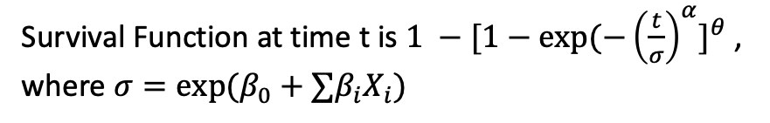
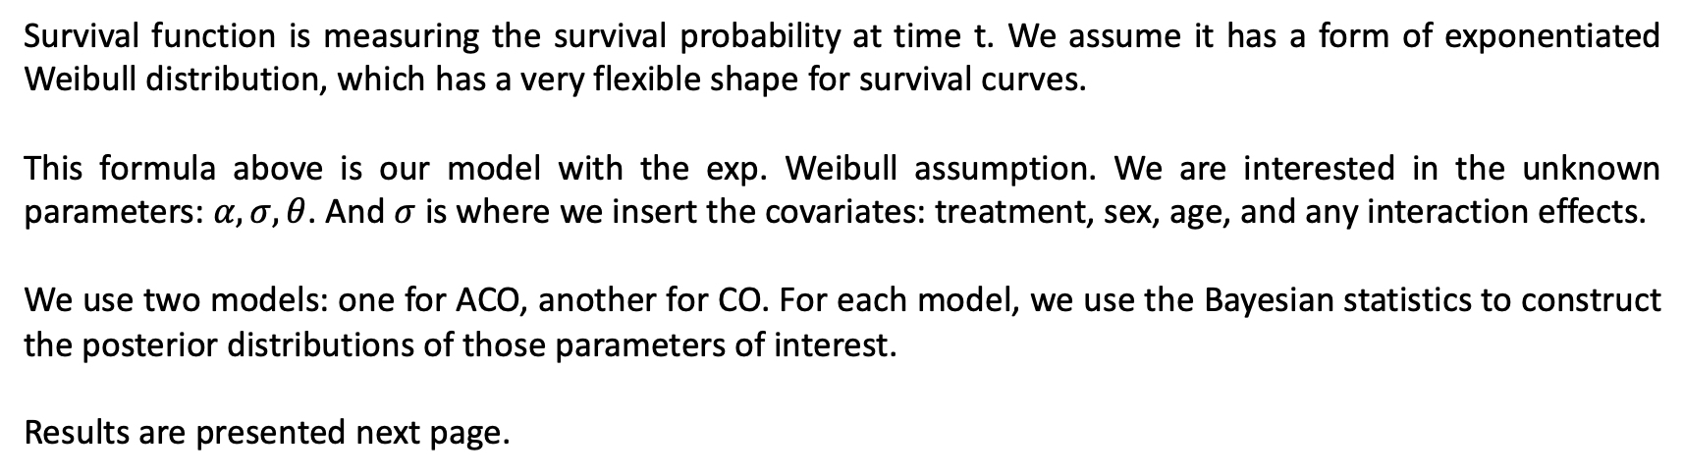
Exponentiated Weibull regression model
Survival Function at time t is $1 −[1−exp⁡(−{\left(\frac{t}{σ}\right)}^{α}]^{θ}$,
where $σ=exp⁡(β_{0}+∑{β_{i}X}_{i})$
Survival function is measuring the survival probability at time t. We assume it has a form of exponentiated Weibull distribution, which has a very flexible shape for survival curves.
This formula above is our model with the exp. Weibull assumption. We are interested in the unknown parameters: $α,σ, θ$. And $σ$ is where we insert the covariates: treatment, sex, age, and any interaction effects.
We use two models: one for ACO, another for CO. For each model, we use the Bayesian statistics to construct the posterior distributions of those parameters of interest.
Results are presented next page.
Notes:
Alpha and theta both control the shape of survival curves
Sigma is called scale parameter
Covariates: treatment, age, sex
They are inserted in sigma
Beta0 is intercept
Bayesian : construct 95% intervals for all known parameters such as alpha, theta beta’s

Slide 29
Model on ACO

Slide 30
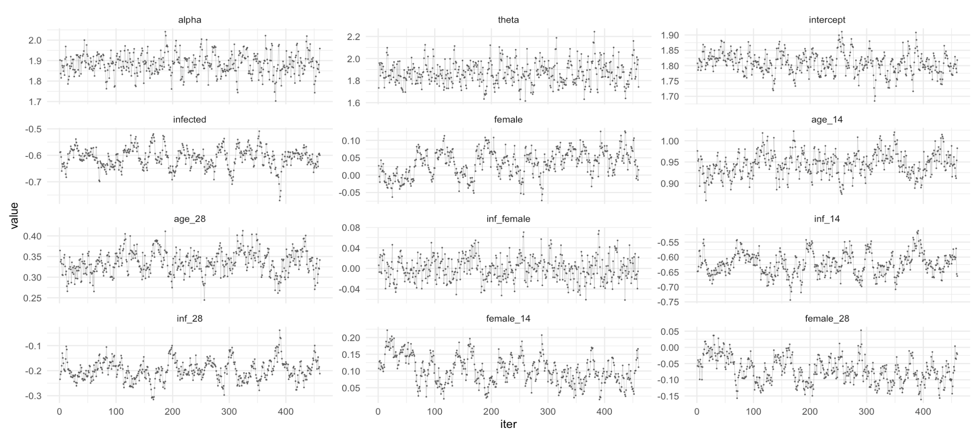
Model on ACO
These are the posterior draws (after thinning) for parameters of interest. Using these draws/distributions, we can find the estimate and 95% interval for each parameter below.

Slide 31
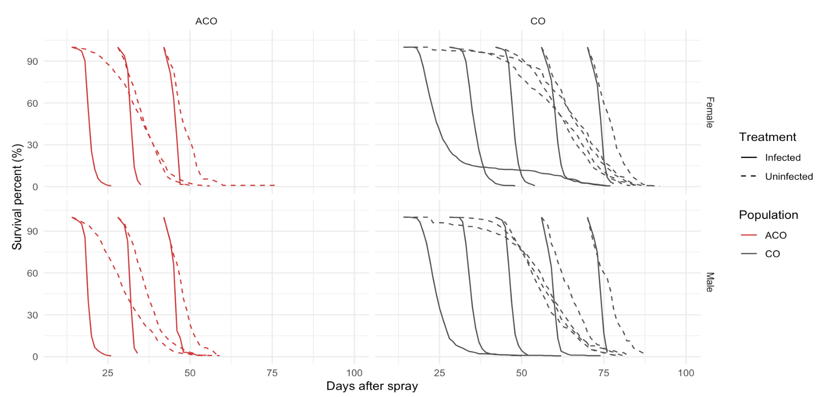
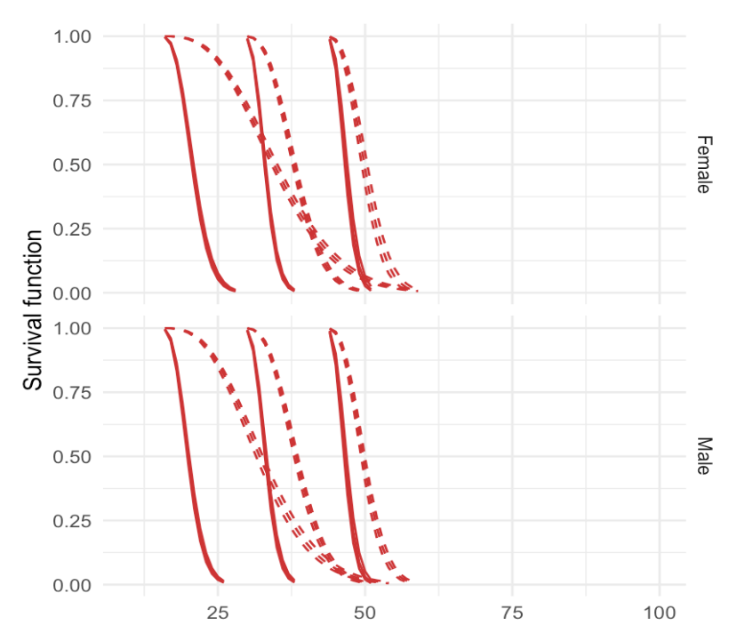
Model on ACO
Our model survival curves (right) is quite close to the raw data (left). If you zoom in a little to the model plot, there are three lines for each sub-group. They are the estimate line, 95% lower bound, and 95% upper bound.
Raw Data Plot
Model Plot
Notes:
Every model has limitation. Sometime it gets off a little. But we will accept it if the main trend/ curves are close to the raw data. Since we are using parametric mmodel, this could happen. Eventually we will turn this into non-parametric model.

Slide 32
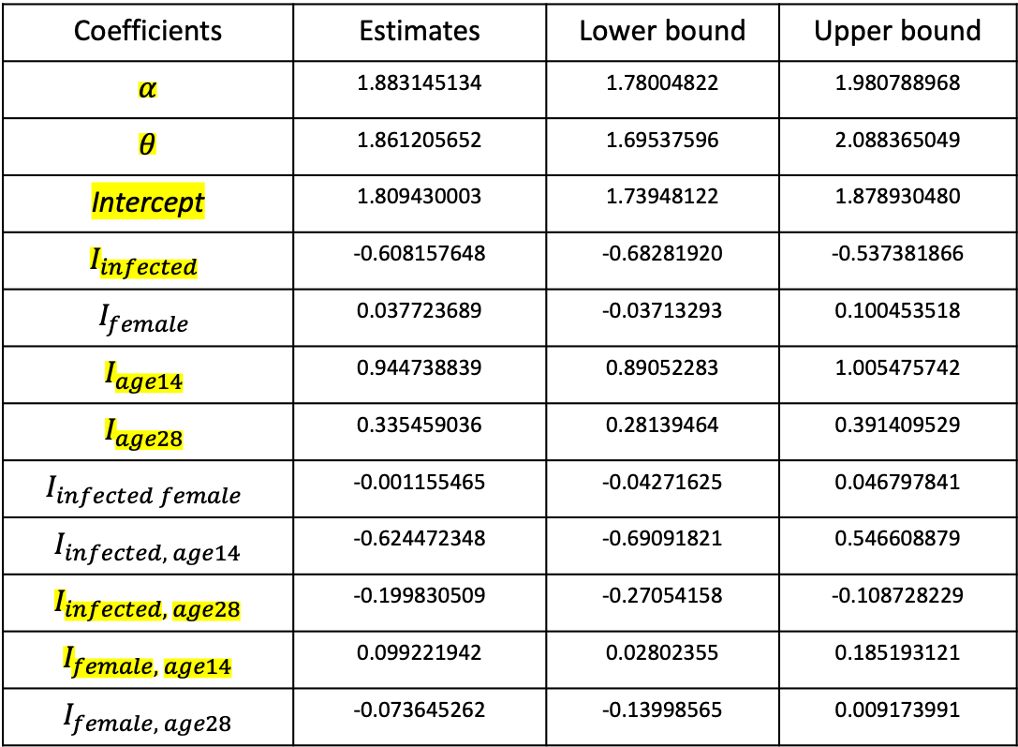
Model on ACO
Significant
Coefficients | Estimates | Lower bound | Upper bound
$$α$$ | 1.883145134 | 1.78004822 | 1.980788968
$$θ$$ | 1.861205652 | 1.69537596 | 2.088365049
Intercept | 1.809430003 | 1.73948122 | 1.878930480
$$I_{infected}$$ | -0.608157648 | -0.68281920 | -0.537381866
$$I_{female}$$ | 0.037723689 | -0.03713293 | 0.100453518
$$I_{age14}$$ | 0.944738839 | 0.89052283 | 1.005475742
$$I_{age28}$$ | 0.335459036 | 0.28139464 | 0.391409529
$$I_{infected female}$$ | -0.001155465 | -0.04271625 | 0.046797841
$$I_{infected, age14}$$ | -0.624472348 | -0.69091821 | 0.546608879
$$I_{infected, age28}$$ | -0.199830509 | -0.27054158 | -0.108728229
$$I_{female, age14}$$ | 0.099221942 | 0.02802355 | 0.185193121
$$I_{female, age28}$$ | -0.073645262 | -0.13998565 | 0.009173991
Notes:
If both alpha and theta above 1, the hazard rate is increasing. Coefficients vs 0

Slide 33
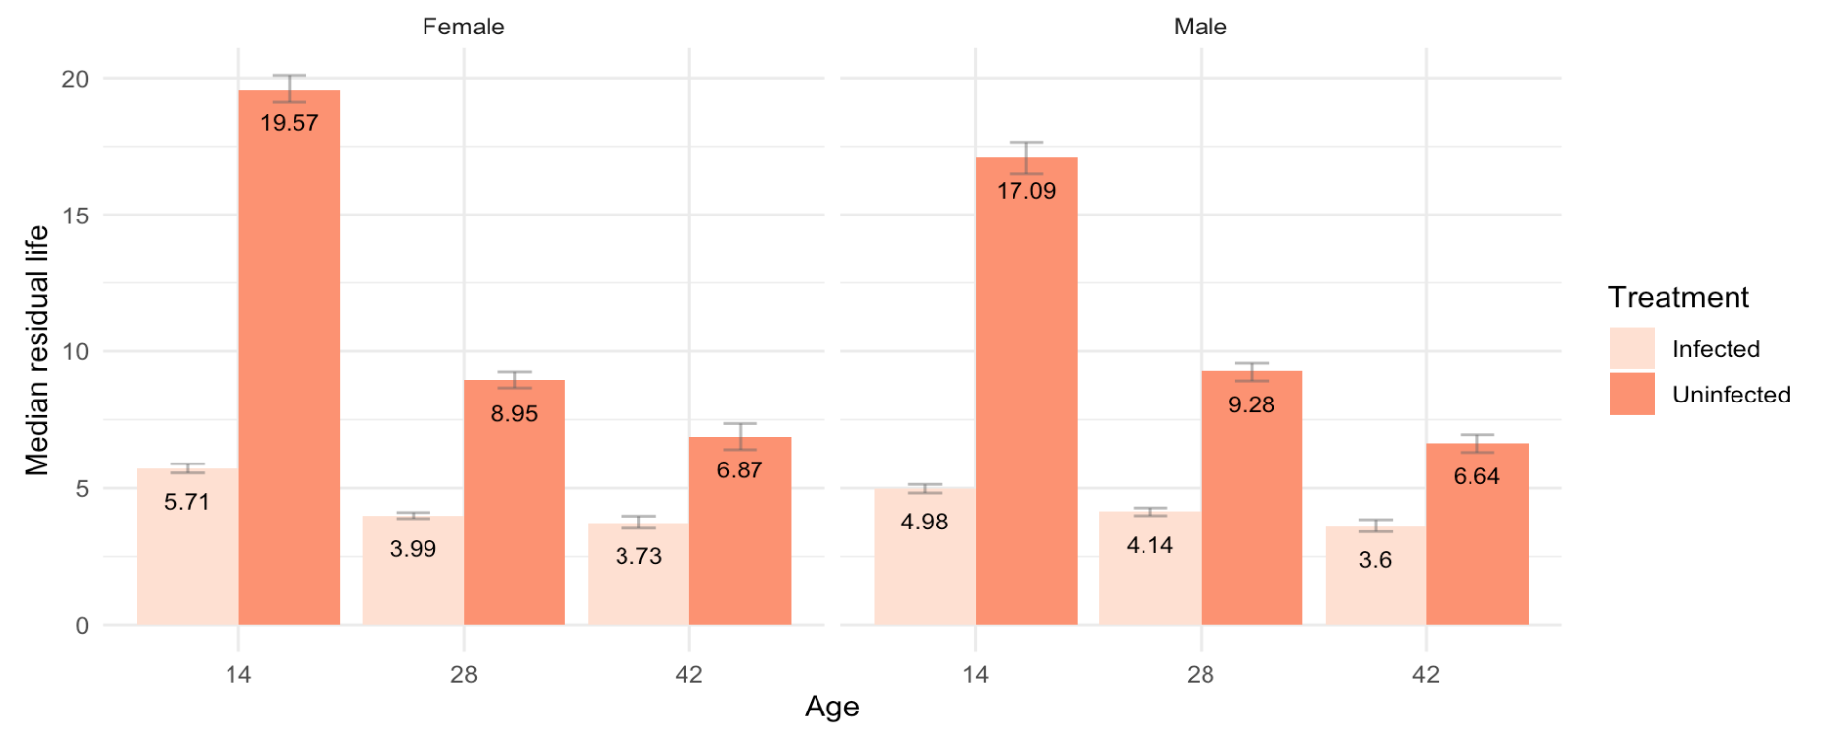
Model on ACO
Below are median estimates and 95% intervals.
Median lifetime

Slide 34
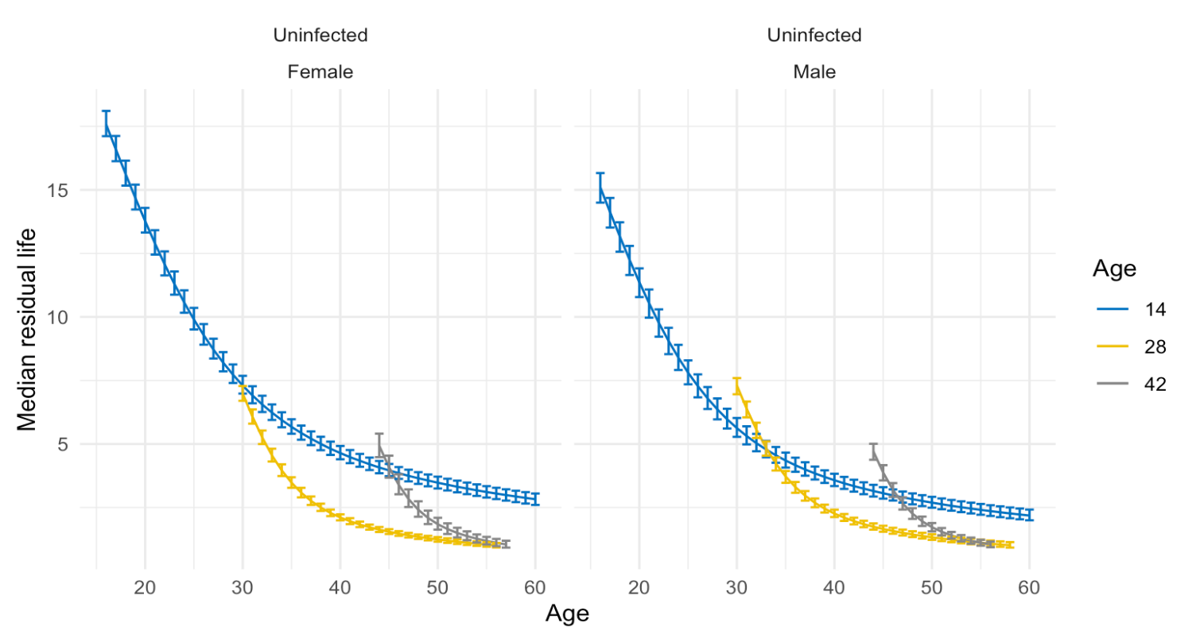
Model on ACO – Immunity measurement 1
Below are median residual life and 95% CI of uninfected flies.

Slide 35
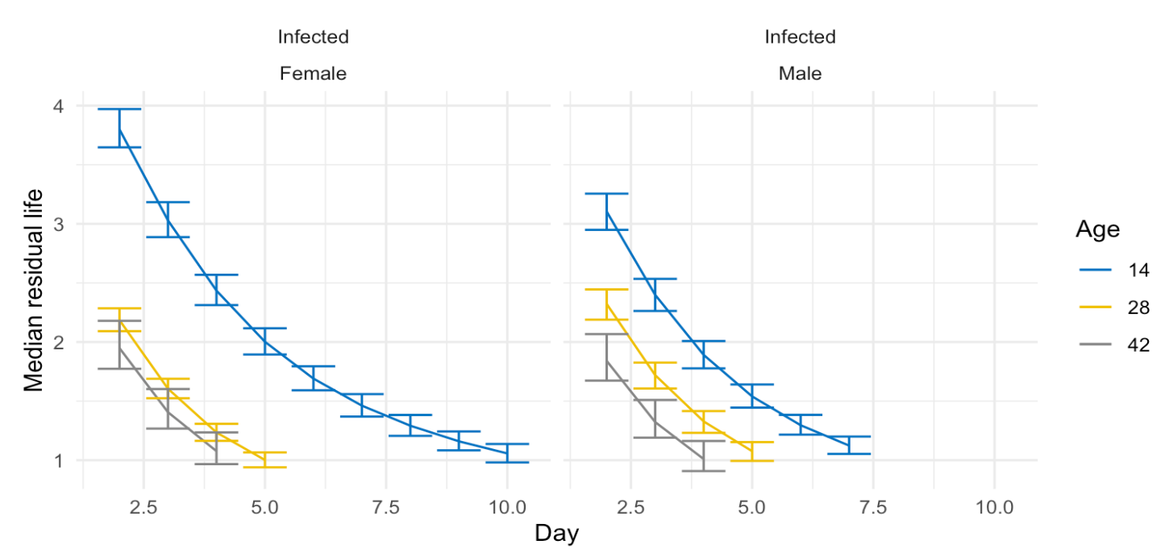
Model on ACO – Immunity measurement 1
Below are median residual life and 95% CI of infected flies.

Slide 36
Model on ACO – Immunity measurement 2
Below are the changes of scales between infected and uninfected.
Survival Function at time t is $1 −[1−exp⁡(−{\left(\frac{t}{σ}\right)}^{α}]^{θ}$,
where $σ=exp⁡(β_{0}+∑{β_{i}X}_{i})$
$$\frac{σ_{infected }−σ_{uninfected} }{σ_{infected}}$$
# age 14 measurement 0.06368858
# age 28 measurement 0.1171852
# age 42 measurement 1

Slide 37
Model on CO

Slide 38
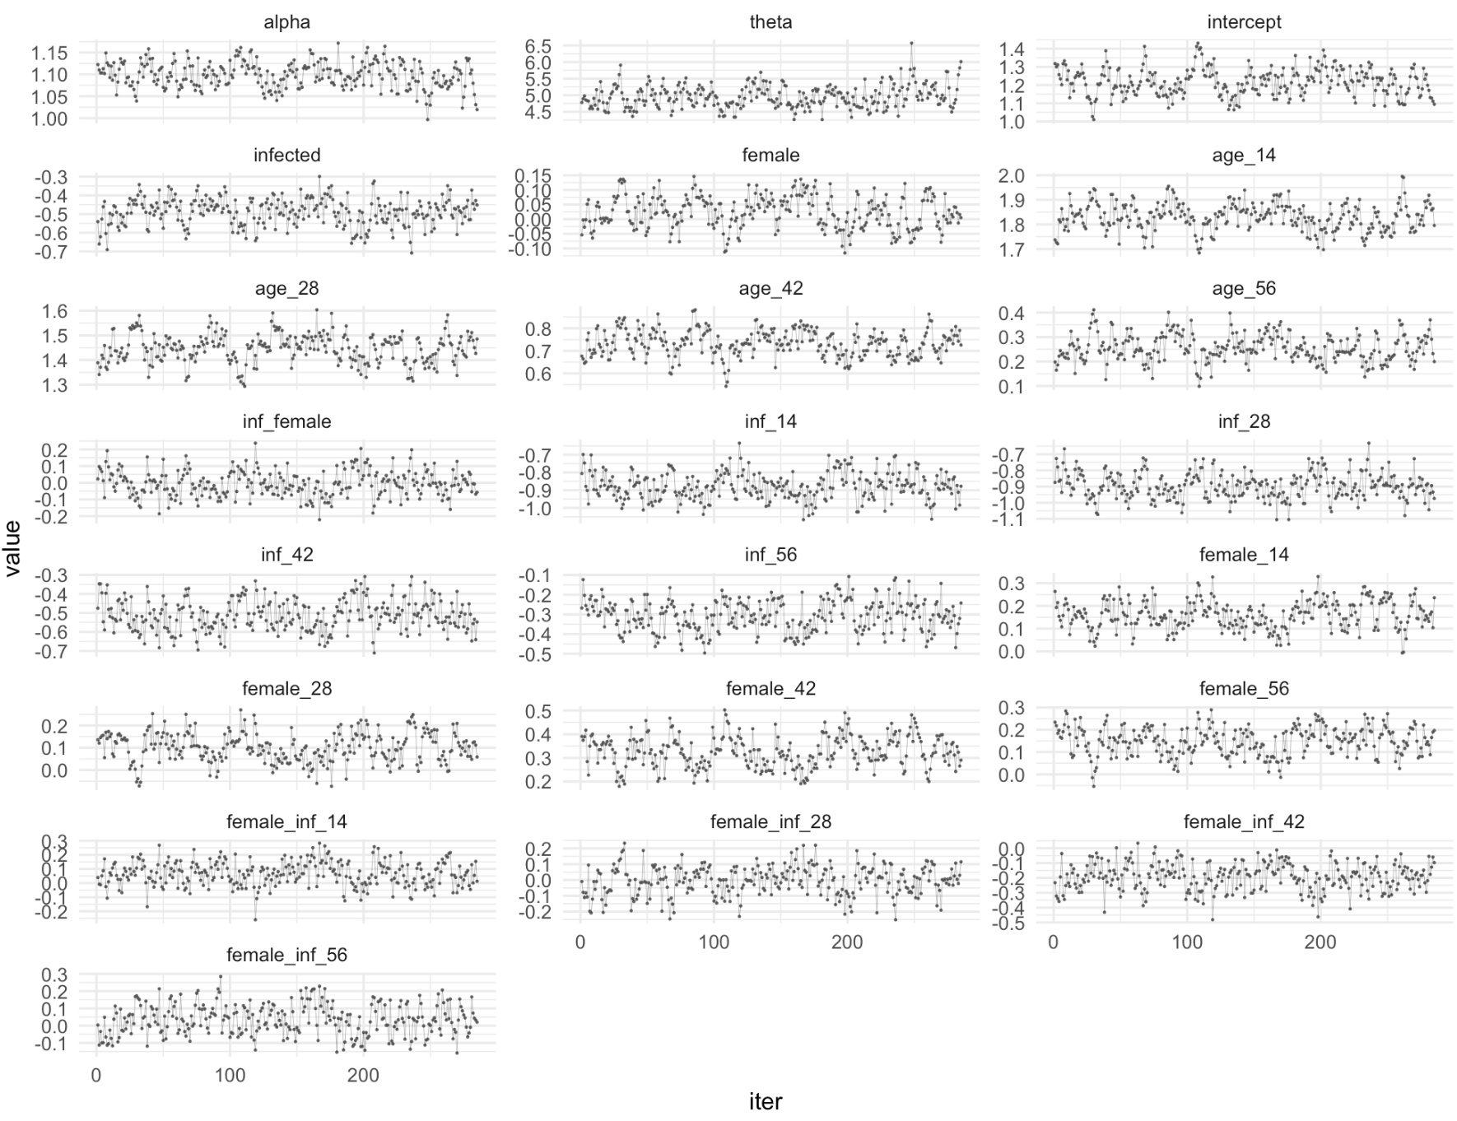
Model on CO
These are the posterior draws (after thinning) for parameters of interest. Using these draws, we can find the estimate and 95% interval for each parameter below.
Here I include the interaction effects between three covariates. Otherwise, the survival function curves are quite off.
But according to the 95% interval, none of these three-way interaction effects is significant.

Slide 39
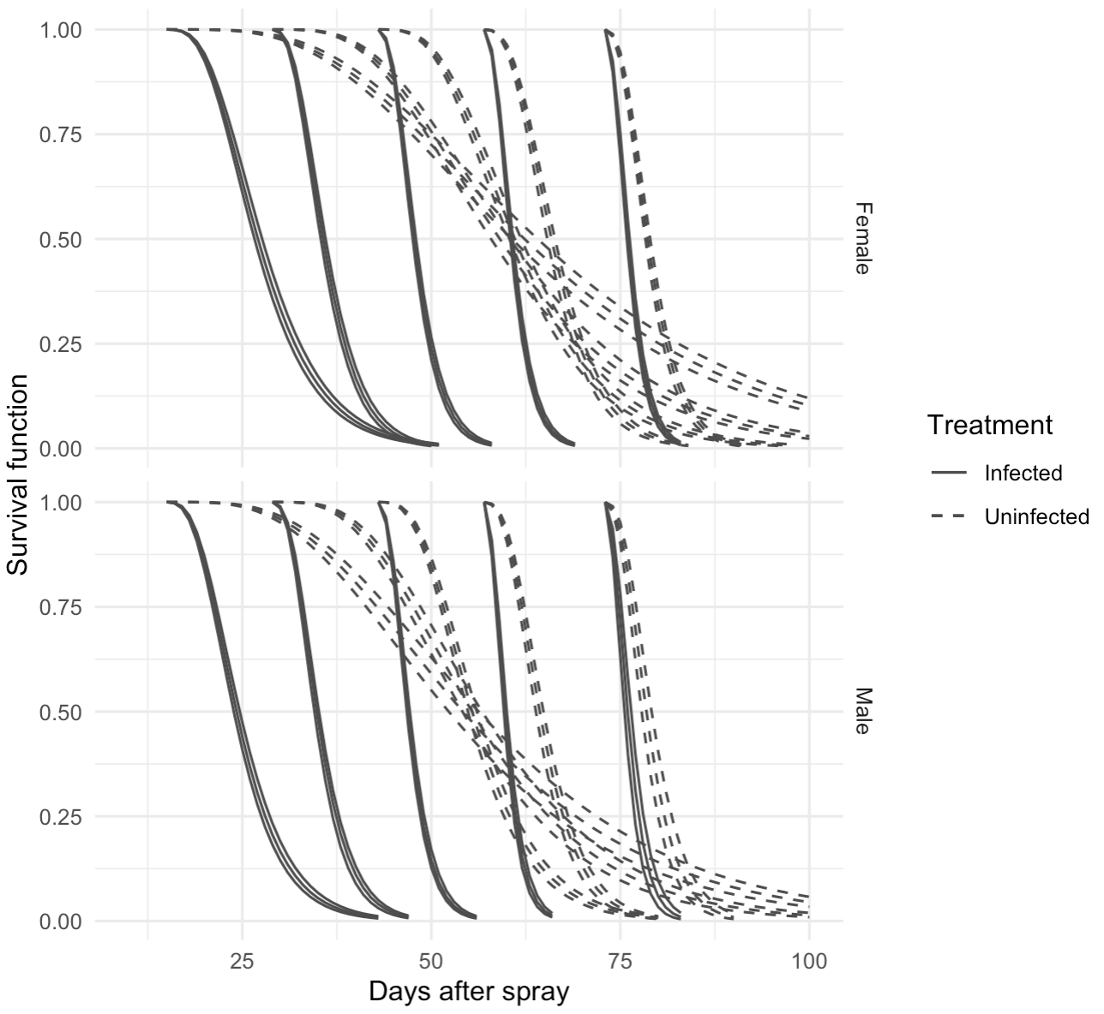
Model on CO
Our model survival curves (right) is quite close to the raw data (left), except that uninfected model curves have very long trails.
Raw Data Plot
Model Plot

Slide 40
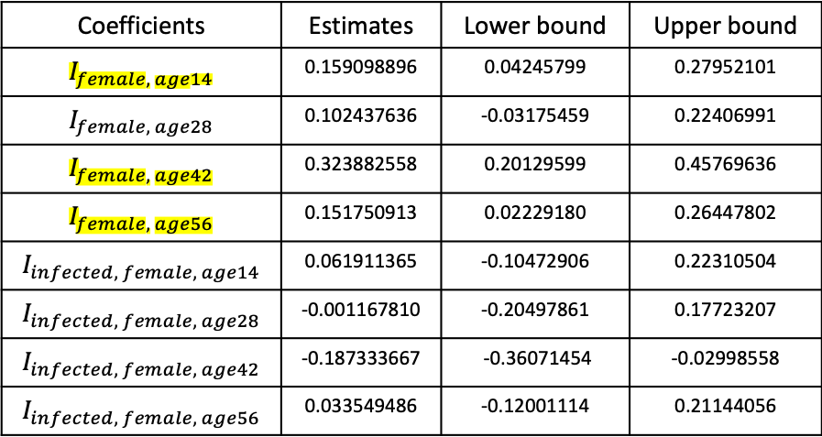
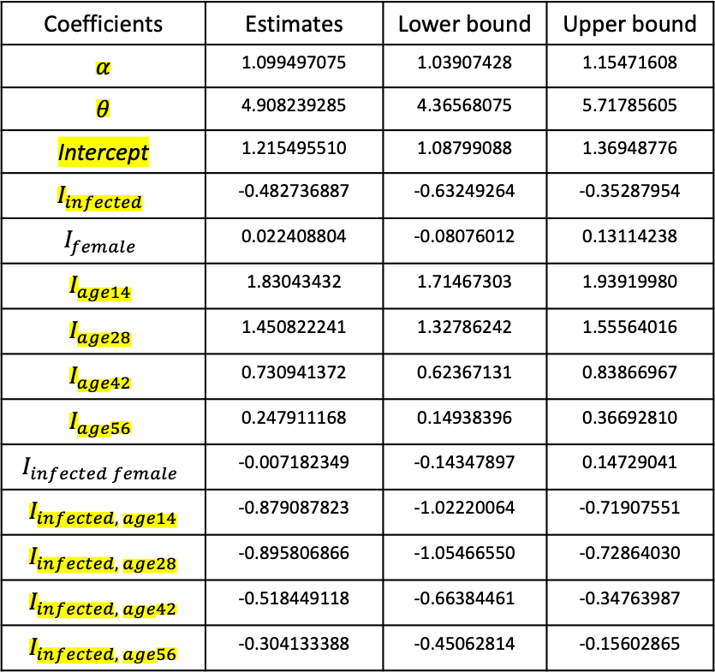
Model on CO
Significant
Coefficients | Estimates | Lower bound | Upper bound
$$α$$ | 1.099497075 | 1.03907428 | 1.15471608
$$θ$$ | 4.908239285 | 4.36568075 | 5.71785605
Intercept | 1.215495510 | 1.08799088 | 1.36948776
$$I_{infected}$$ | -0.482736887 | -0.63249264 | -0.35287954
$$I_{female}$$ | 0.022408804 | -0.08076012 | 0.13114238
$$I_{age14}$$ | 1.83043432 | 1.71467303 | 1.93919980
$$I_{age28}$$ | 1.450822241 | 1.32786242 | 1.55564016
$$I_{age42}$$ | 0.730941372 | 0.62367131 | 0.83866967
$$I_{age56}$$ | 0.247911168 | 0.14938396 | 0.36692810
$$I_{infected female}$$ | -0.007182349 | -0.14347897 | 0.14729041
$$I_{infected, age14}$$ | -0.879087823 | -1.02220064 | -0.71907551
$$I_{infected, age28}$$ | -0.895806866 | -1.05466550 | -0.72864030
$$I_{infected, age42}$$ | -0.518449118 | -0.66384461 | -0.34763987
$$I_{infected, age56}$$ | -0.304133388 | -0.45062814 | -0.15602865
Coefficients | Estimates | Lower bound | Upper bound
$$I_{female, age14}$$ | 0.159098896 | 0.04245799 | 0.27952101
$$I_{female, age28}$$ | 0.102437636 | -0.03175459 | 0.22406991
$$I_{female, age42}$$ | 0.323882558 | 0.20129599 | 0.45769636
$$I_{female, age56}$$ | 0.151750913 | 0.02229180 | 0.26447802
$$I_{infected, female, age14}$$ | 0.061911365 | -0.10472906 | 0.22310504
$$I_{infected, female, age28}$$ | -0.001167810 | -0.20497861 | 0.17723207
$$I_{infected, female, age42}$$ | -0.187333667 | -0.36071454 | -0.02998558
$$I_{infected, female, age56}$$ | 0.033549486 | -0.12001114 | 0.21144056

Slide 41
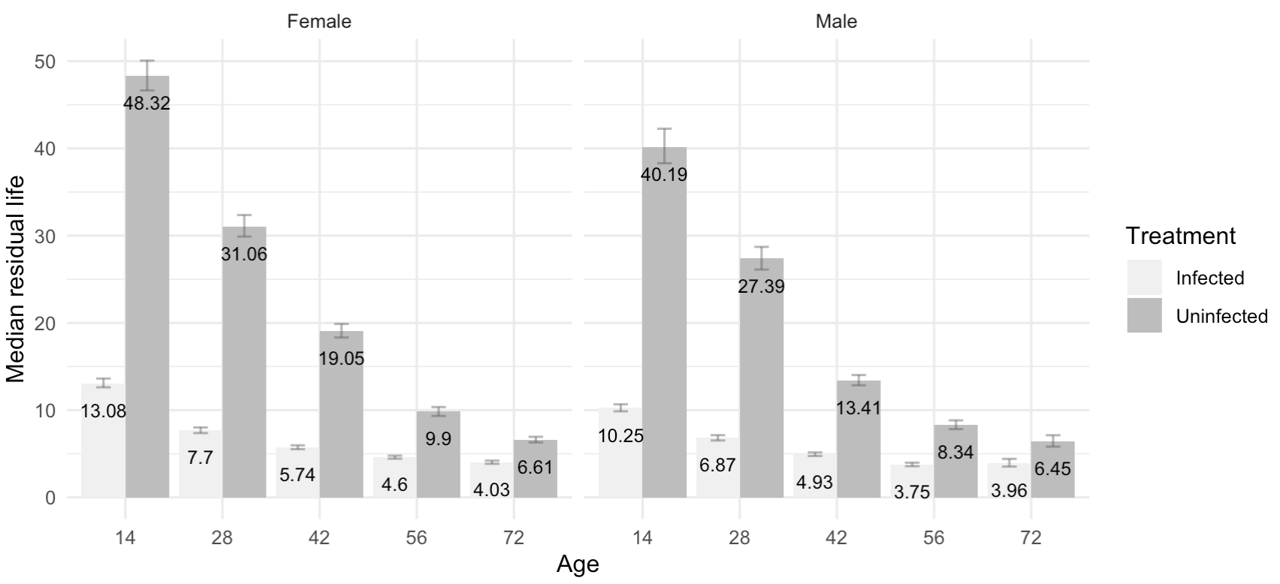
Model on CO
Below are median life estimates and 95% intervals.
Median lifetime

Slide 42
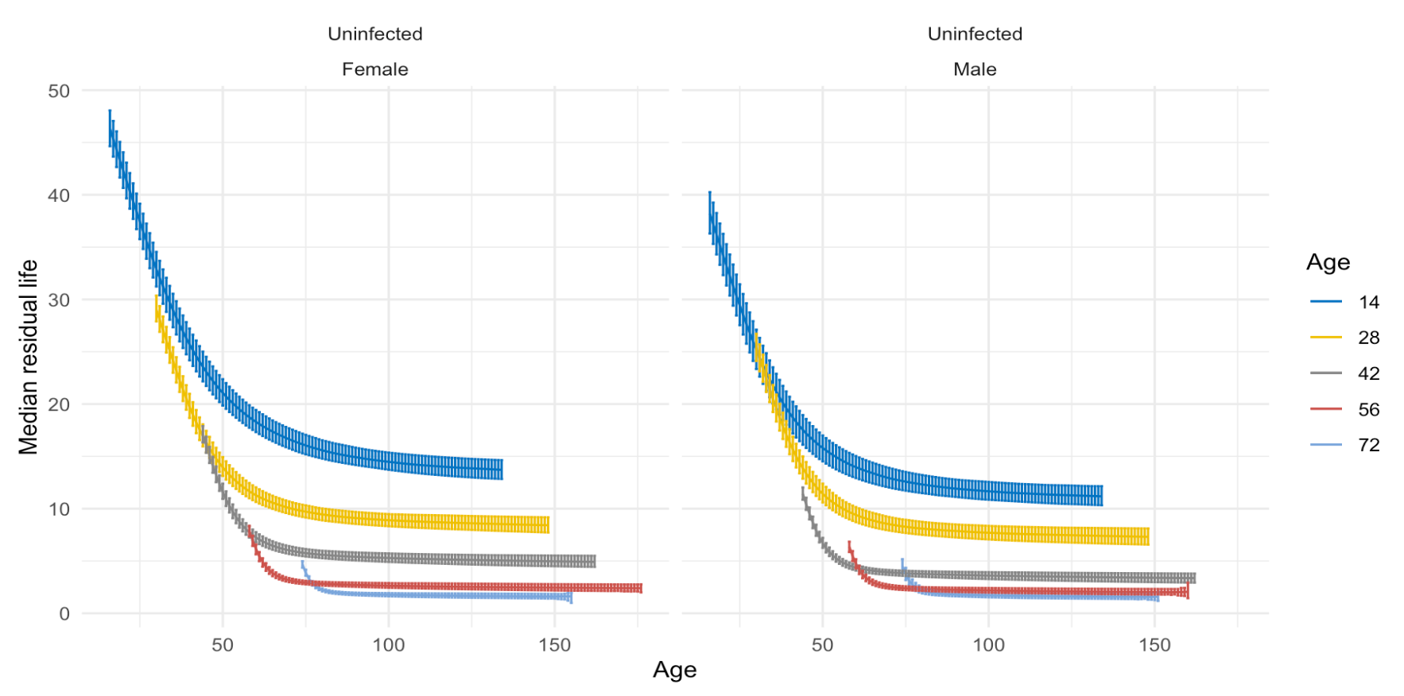
Model on CO – Immunity measurement 1
Below are median residual life and 95% CI of uninfected flies.

Slide 43
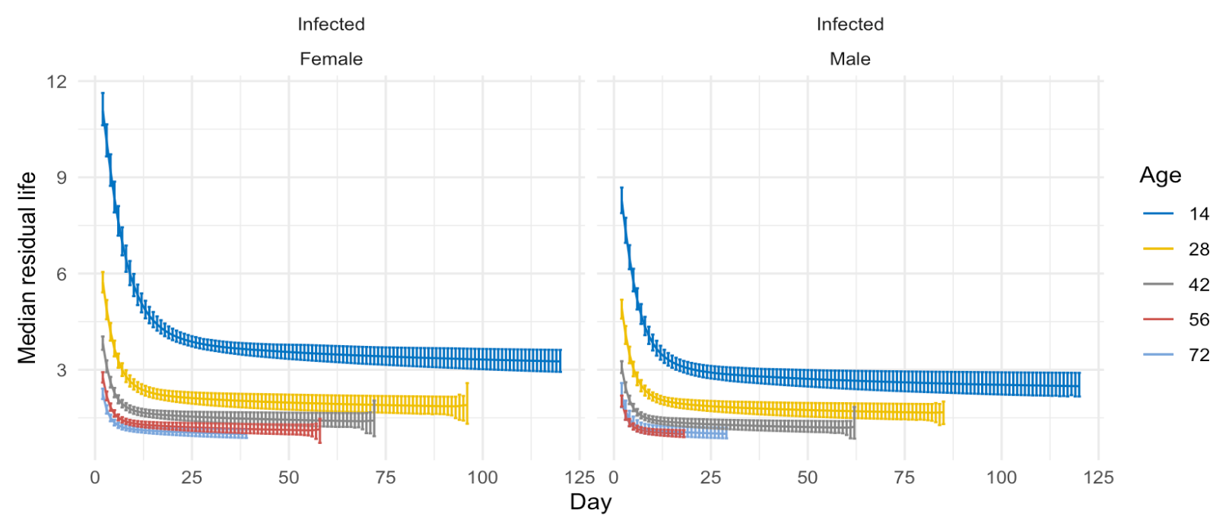
Model on CO – Immunity measurement 1
Below are median residual life and 95% CI of infected flies.

Slide 44
Model on CO – Immunity measurement 2
Below are the changes of scales between infected and uninfected.
Survival Function at time t is $1 −[1−exp⁡(−{\left(\frac{t}{σ}\right)}^{α}]^{θ}$,
where $σ=exp⁡(β_{0}+∑{β_{i}X}_{i})$
$$\frac{σ_{infected }−σ_{uninfected} }{σ_{infected}}$$
# age 14 measurement 0.04746798
# age 28 measurement 0.06959935
# age 42 measurement 0.1429872
# age 56 measurement 0.2315869
# age 70 measurement 1

